Slide 1
Google Play Review Sentiment Analysis
Michael Yan

Slide 2
Project Goal
Ten of thousands of players writing reviews on apps each day.
Each review contains textual feedback along with a 1-5-star rating system
To quantify player satisfaction coming from these comments to help with further business decisions.

Slide 3
Sentiment Analysis Process

Slide 4
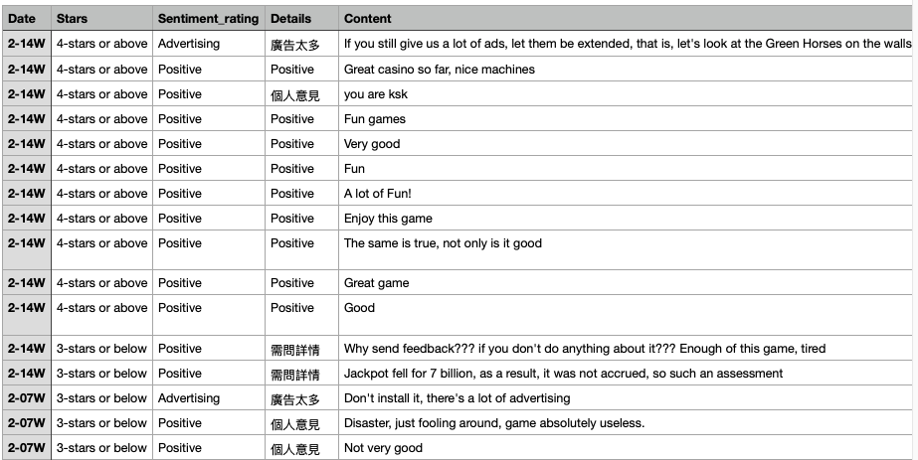
Step 1:
Collecting Data
Used the dataset which found on the Google Play Store
Mainly focusing on slot games.
More than 1,000 review each month.

Slide 5
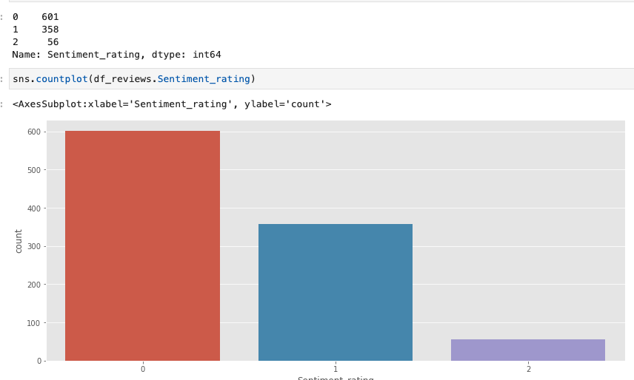
Step 2:
Data Processing
Manually label all the review comments
Standardizing the ratings for sentiment analysis
Converting words to lower case
Removing special characters
Stopwords removal
Lemmatization

Slide 6
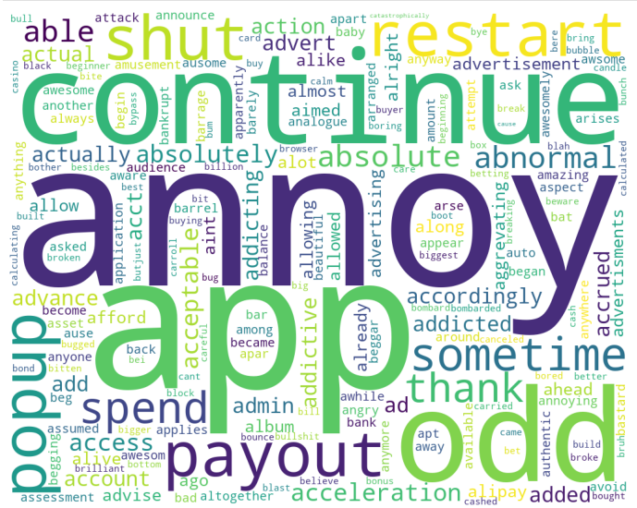
Step 3:
Applying Model:
Logistic Regression
Random Forest
TF-IDF Model

Slide 7
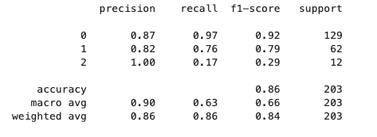
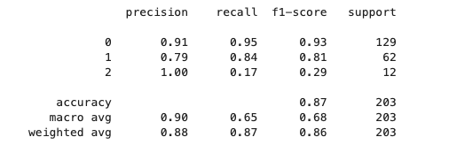
Step 4:
Model Evaluation:
Accuracy Score approx 86% on Logistic Regression and TF-IDF Model
Accuracy Score approx 89% on Random Forest

Slide 8
Further Thoughts
More Training has to be done since different users have different writing pattern
Different language play a part on Google Play reviews. The translation of different language may cause a misunderstanding

Slide 9
Application in Sentiment Analysis:
Through Analyzing players comments can help improving the overall user experience of the apps.

Slide 10
Thank You!

